Slide 1
Automate Your Friend’s Home
Team BDOP(C) | 23. Juni 2017

Slide 2
Our Friend
General
Technician
Married
Two Kids
Enough $$
But likes to tinker
and is concered about smart home privacy issues
Likes the idea of remote controlling his house
He also apparrently has too much free time

Slide 3
Solution
General
Built from the scratch
Using Wemos D1 Mini / Raspberry Pi
A lot of time
Home Assistant automation
No unessesary expensive stuff
House
Has preinstalled RC window shades
Has preinstalled RC pool cover
AC

Slide 4
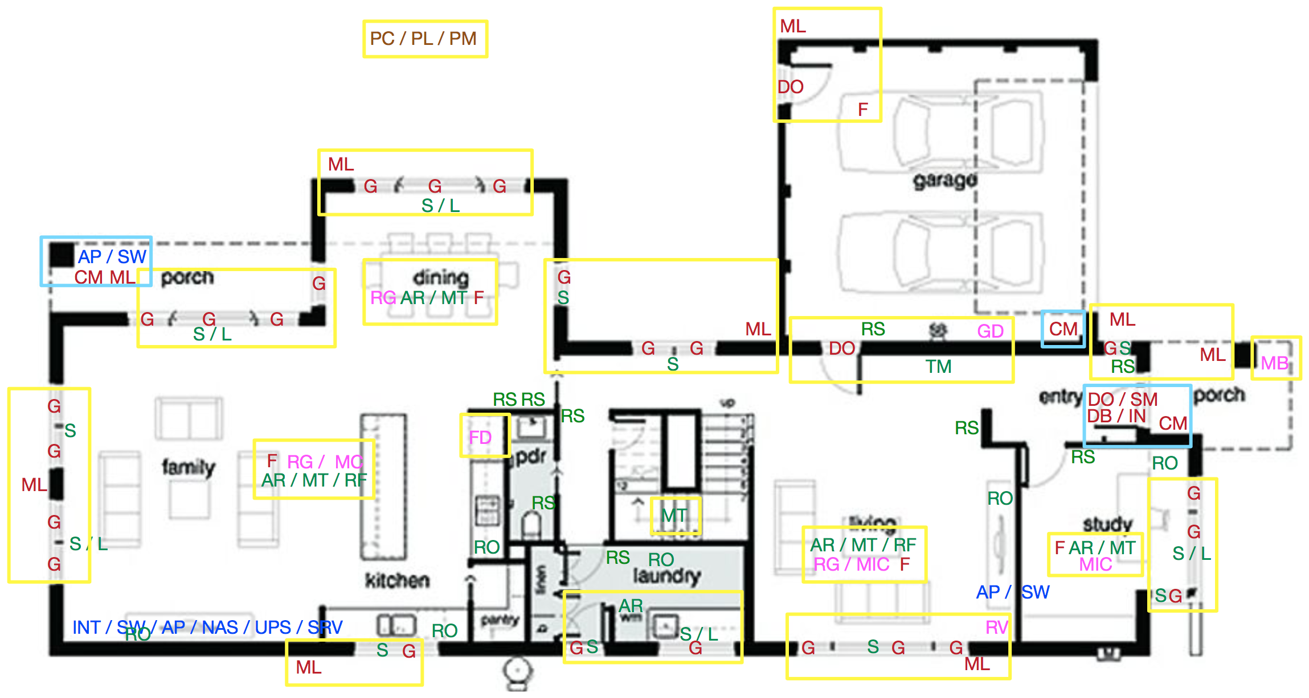
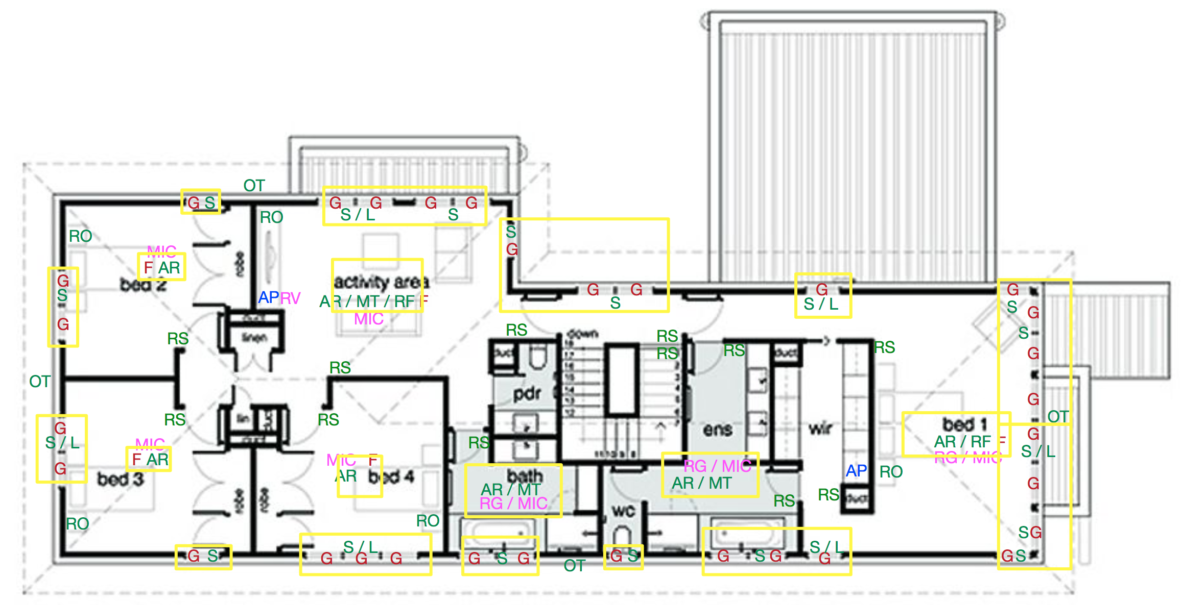
Complete Setup

Slide 5
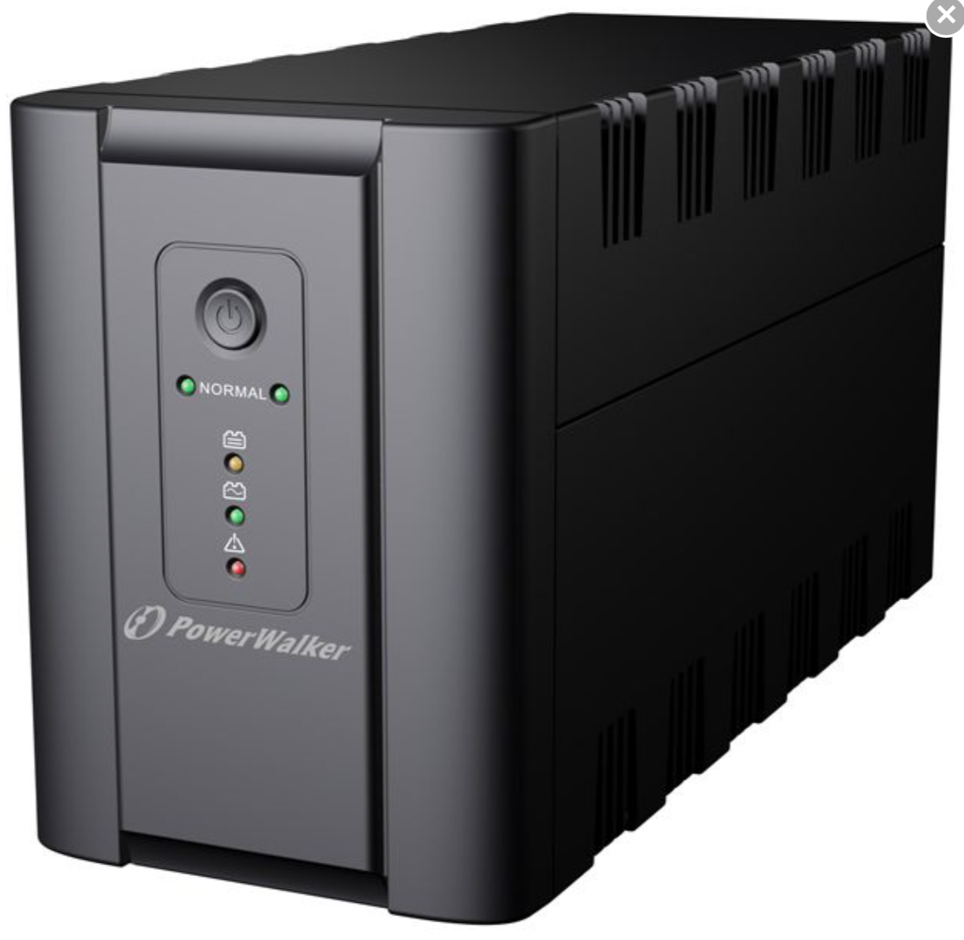
Networking
General
WiFi Connection in and around the house
Wired connection for camera streams
Camera recording stored on NAS
UPS
PoE+
Central Hassbian server

Slide 6
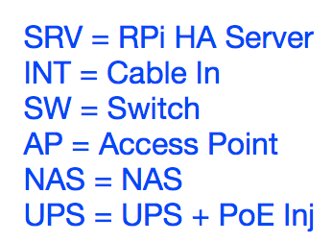
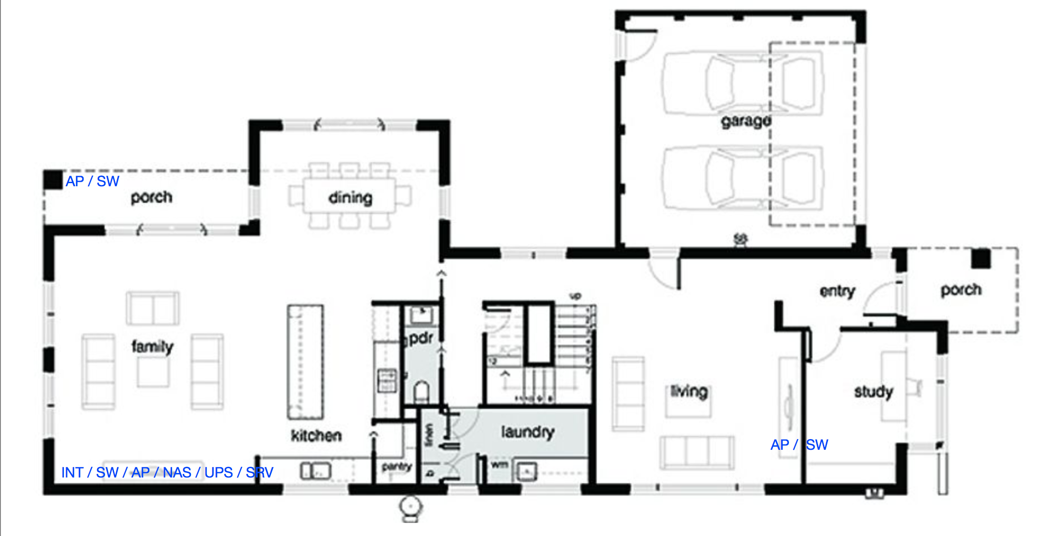
Networking – Ground Floor
Total Sum: 343€

Slide 7
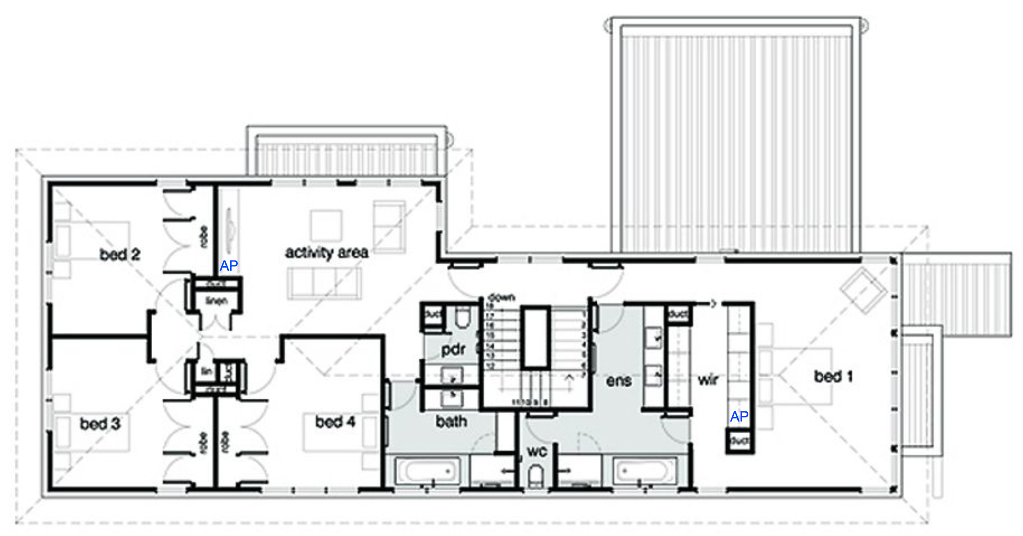
Networking – Upper Floor
Total Sum: 685€

Slide 8
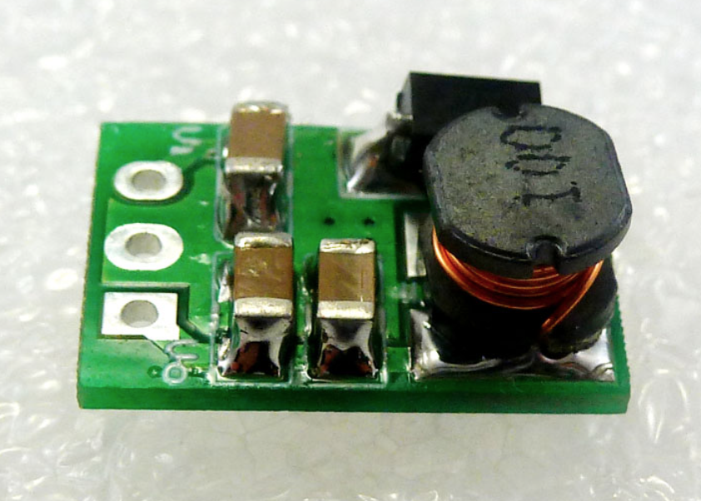
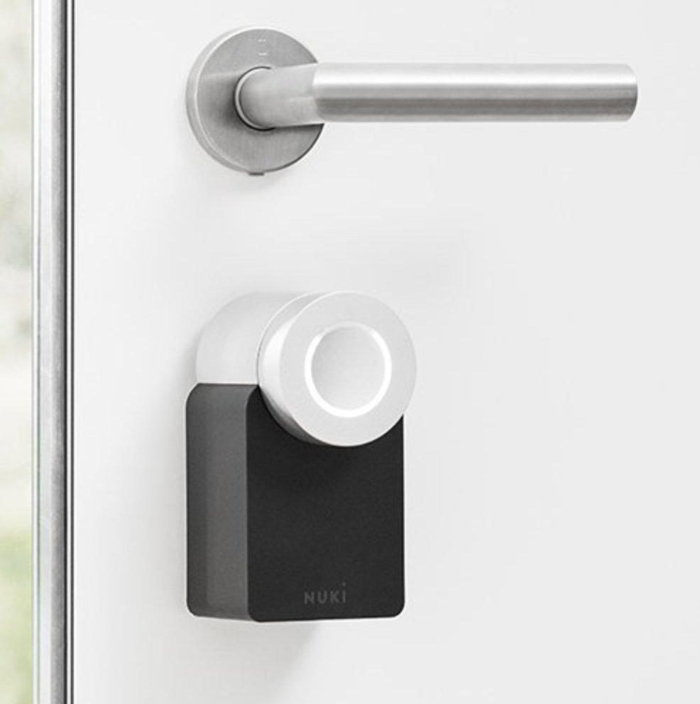
Security
General
Glass Break Sensors (Switch)
Cameras + IR
Motion Sensor
Outdoor Light (LED)
Fire Alarm (Switch)
Door Bell (Level Shifter + Input)
Door Opener (Relay)
Smart Lock (Nuki, HTTPS)
Intercom (Relay)

Slide 9
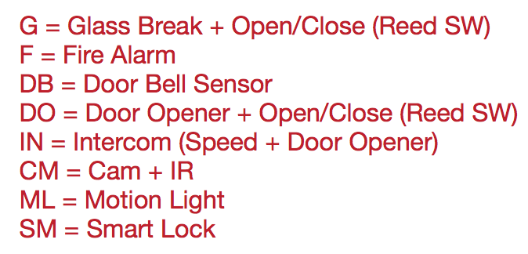
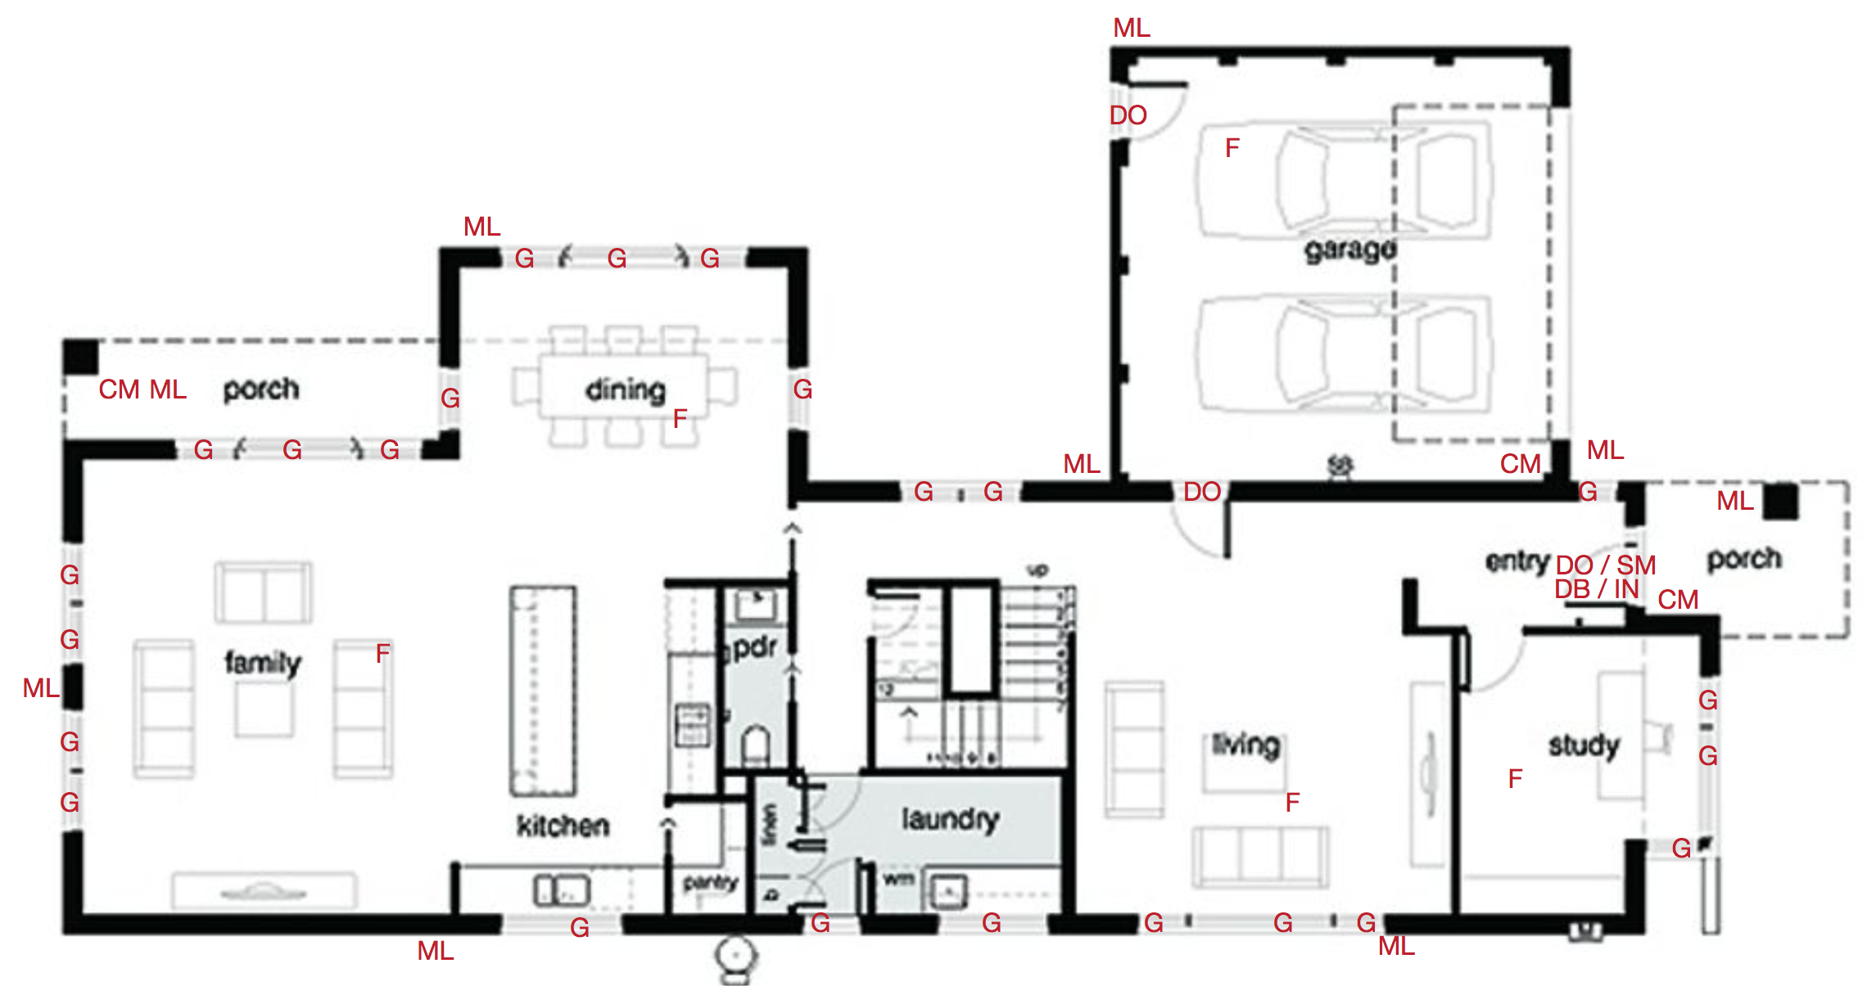
Security – Ground Floor
Total Sum: 2016€

Slide 10
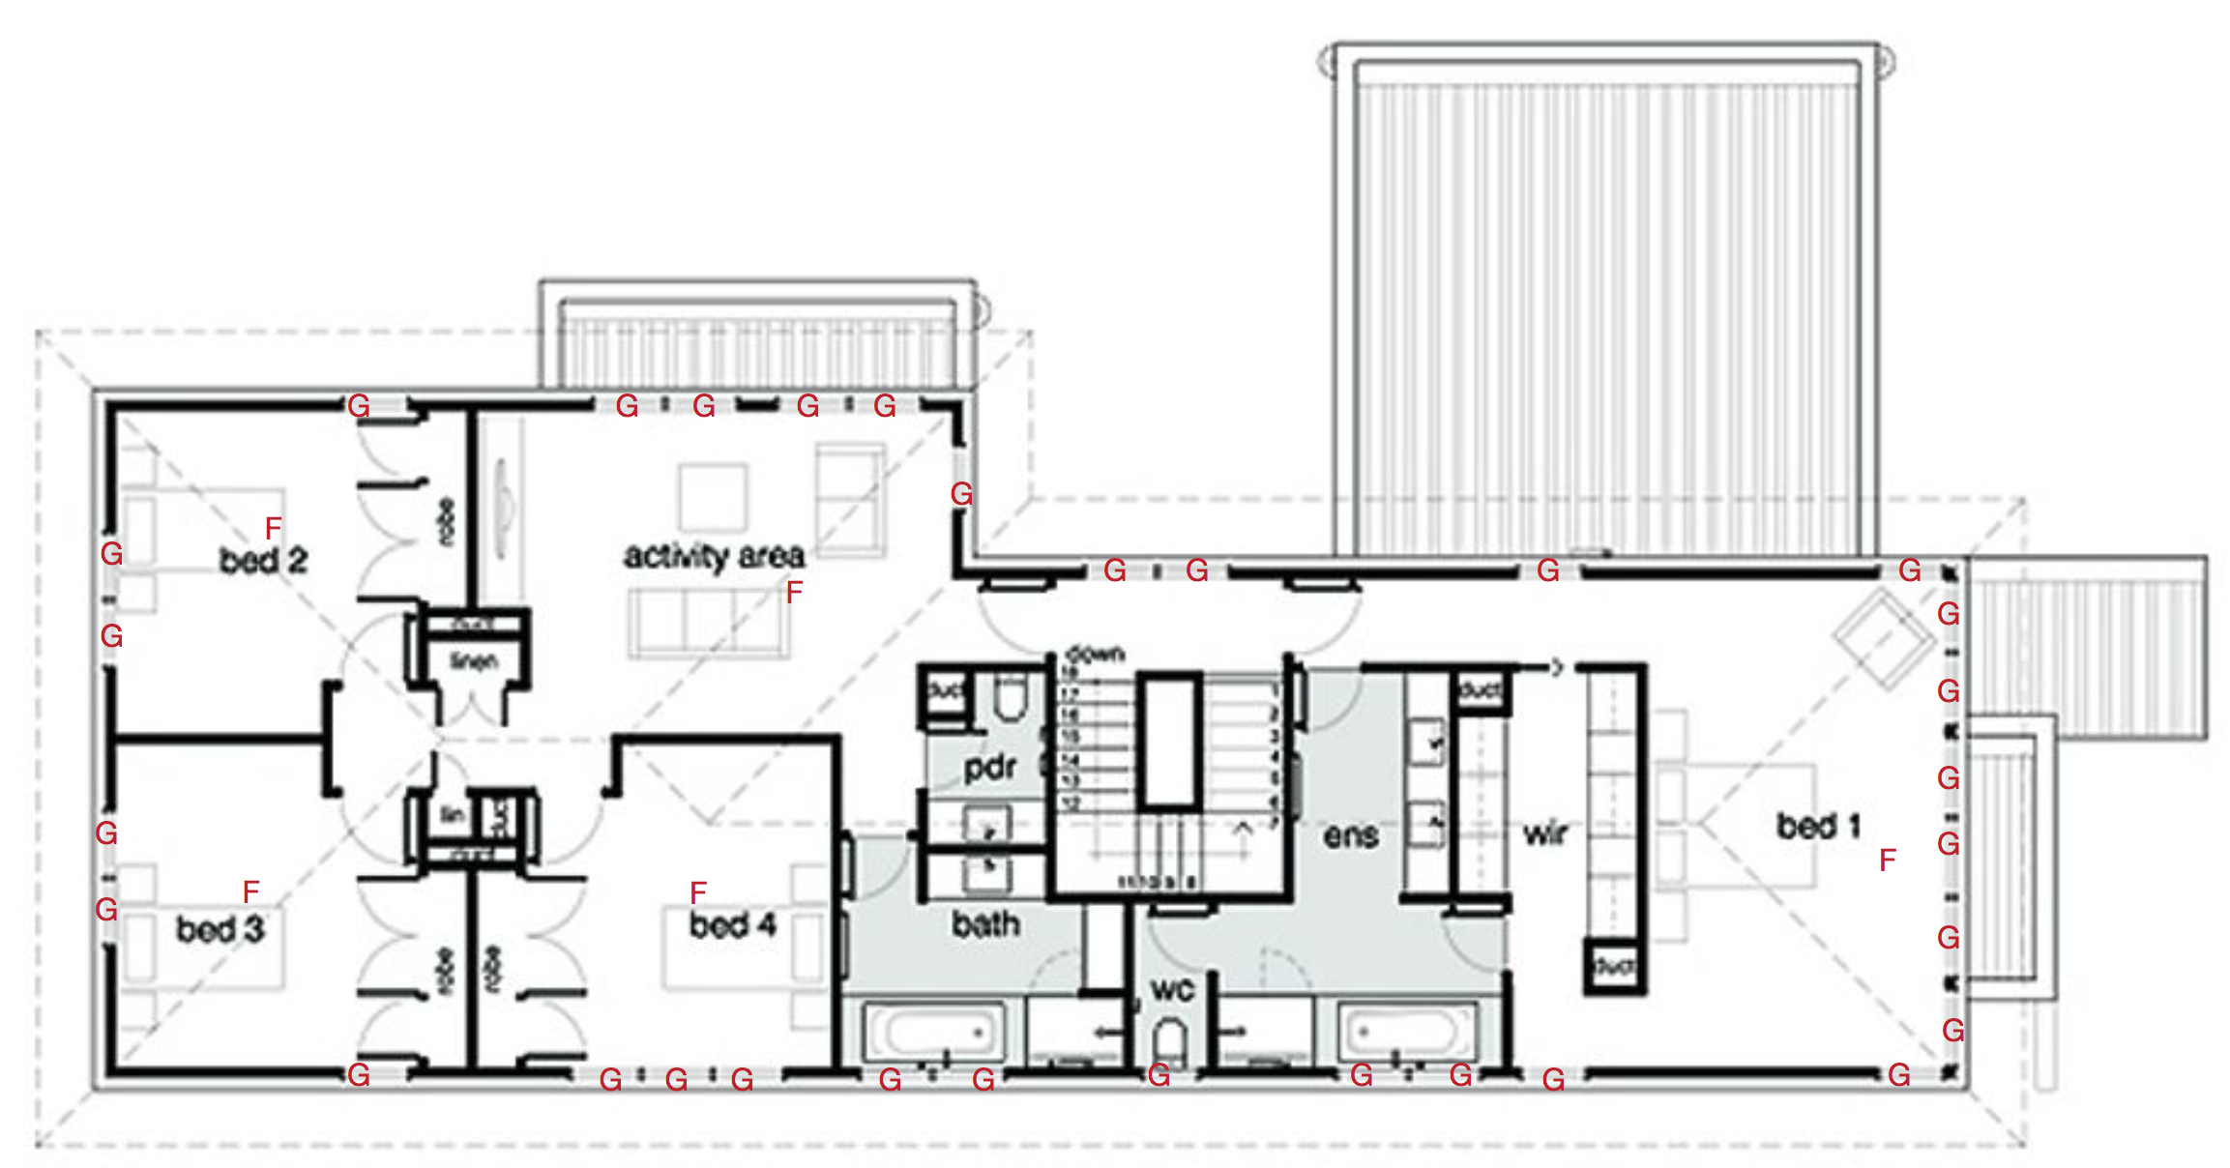
Security – Upper Floor
Total Sum: 3347€

Slide 11

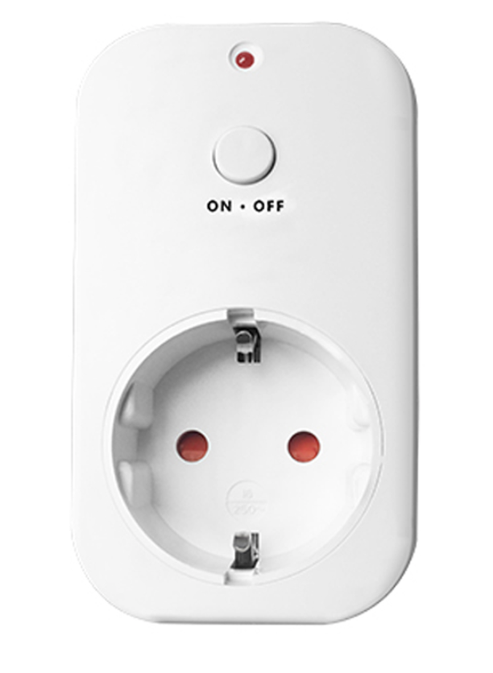
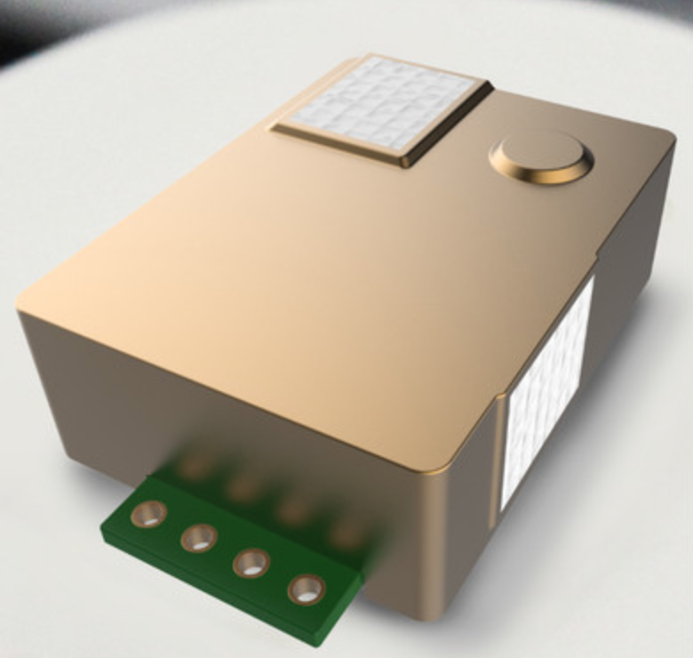
Energy
General
Switches (RF, 433MHz)
Power Outlets
Air Quality Measurements
Temperature (Indoor / Outdoor)
Humidity
CO2
Motion Sensors
Lightsensors
Thermostat (Relay)
Window Shades

Slide 12
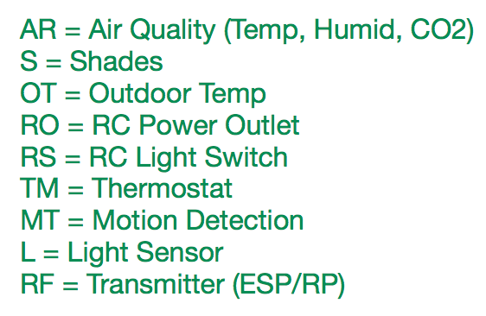
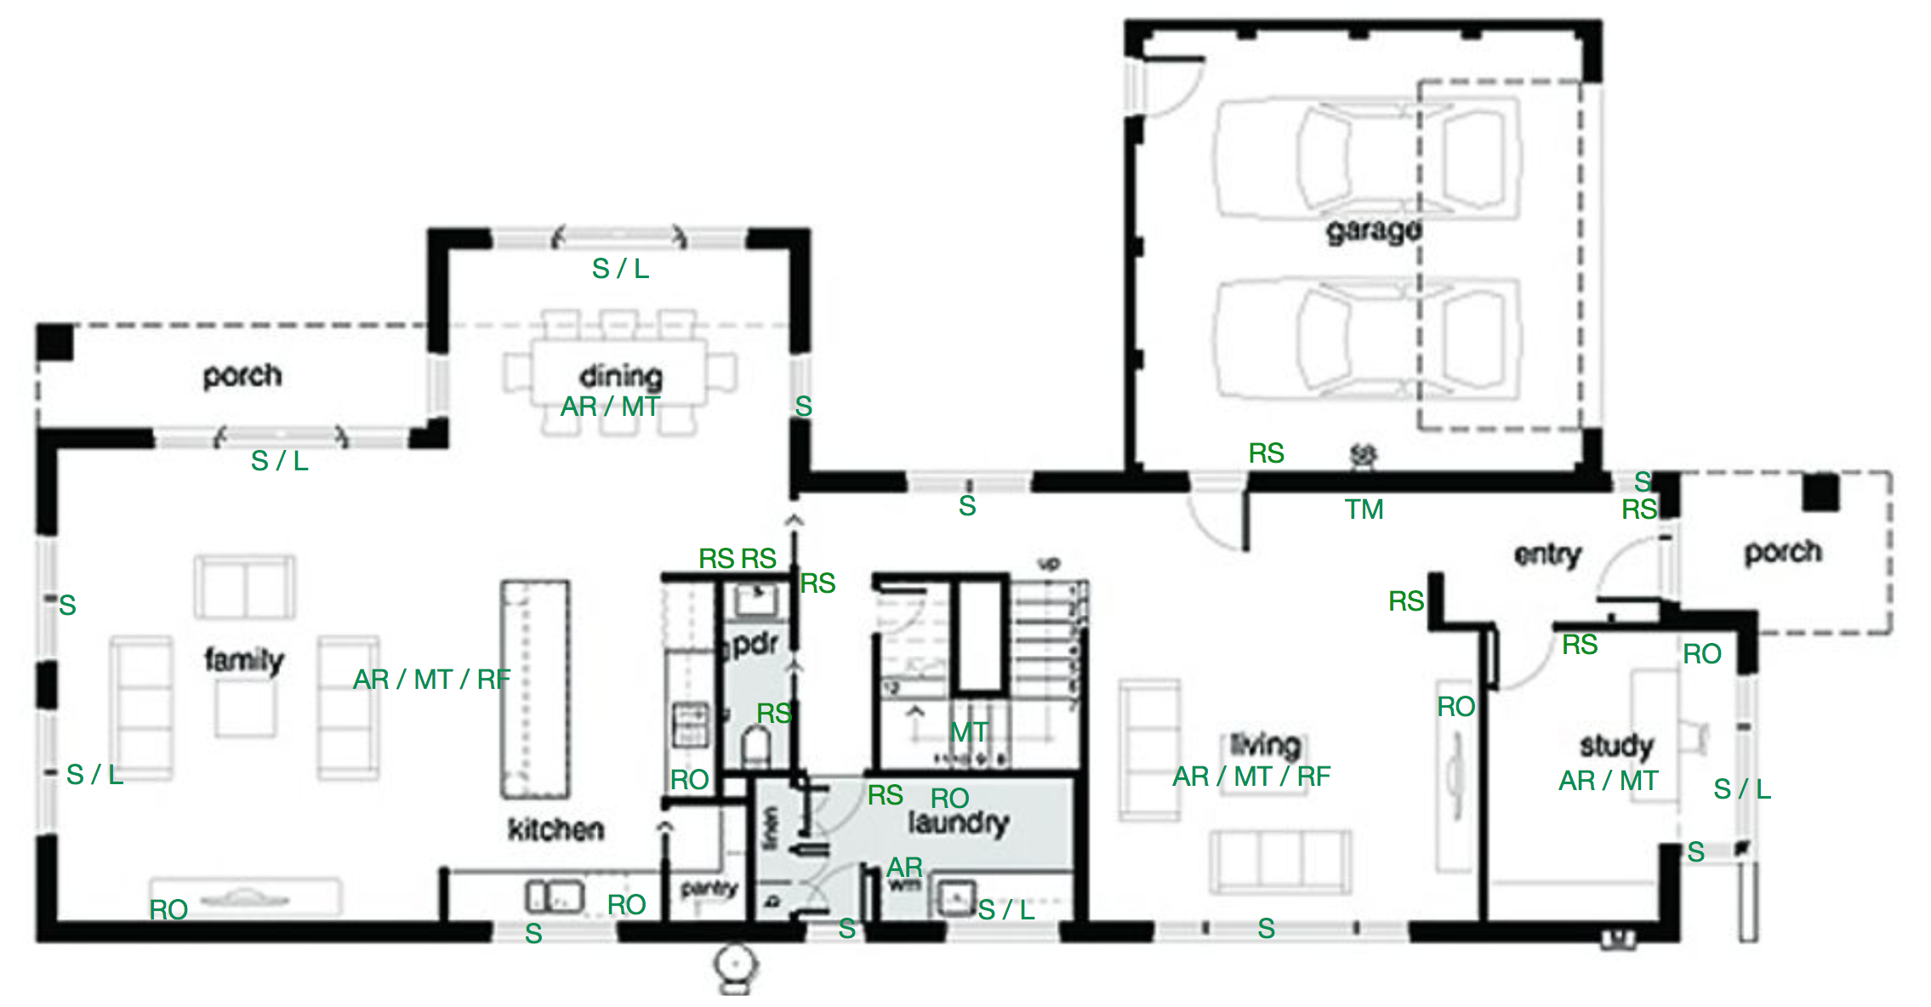
Energy – Ground Floor
Total Sum: 3802€

Slide 13
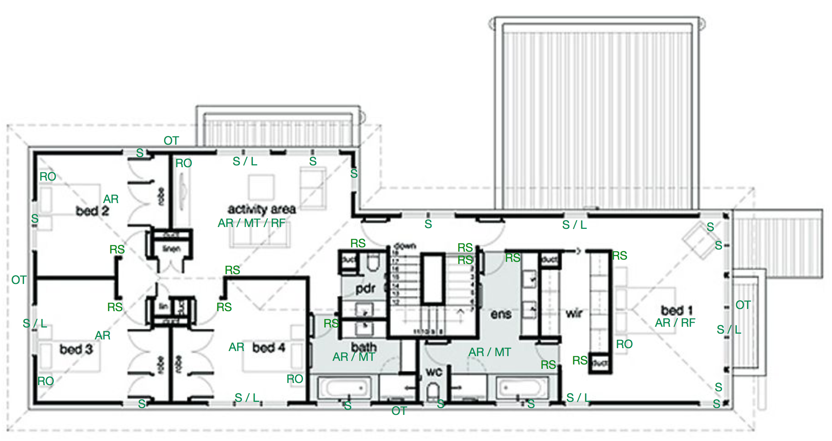
Energy – Upper Floor
Total Sum: 4257€

Slide 14
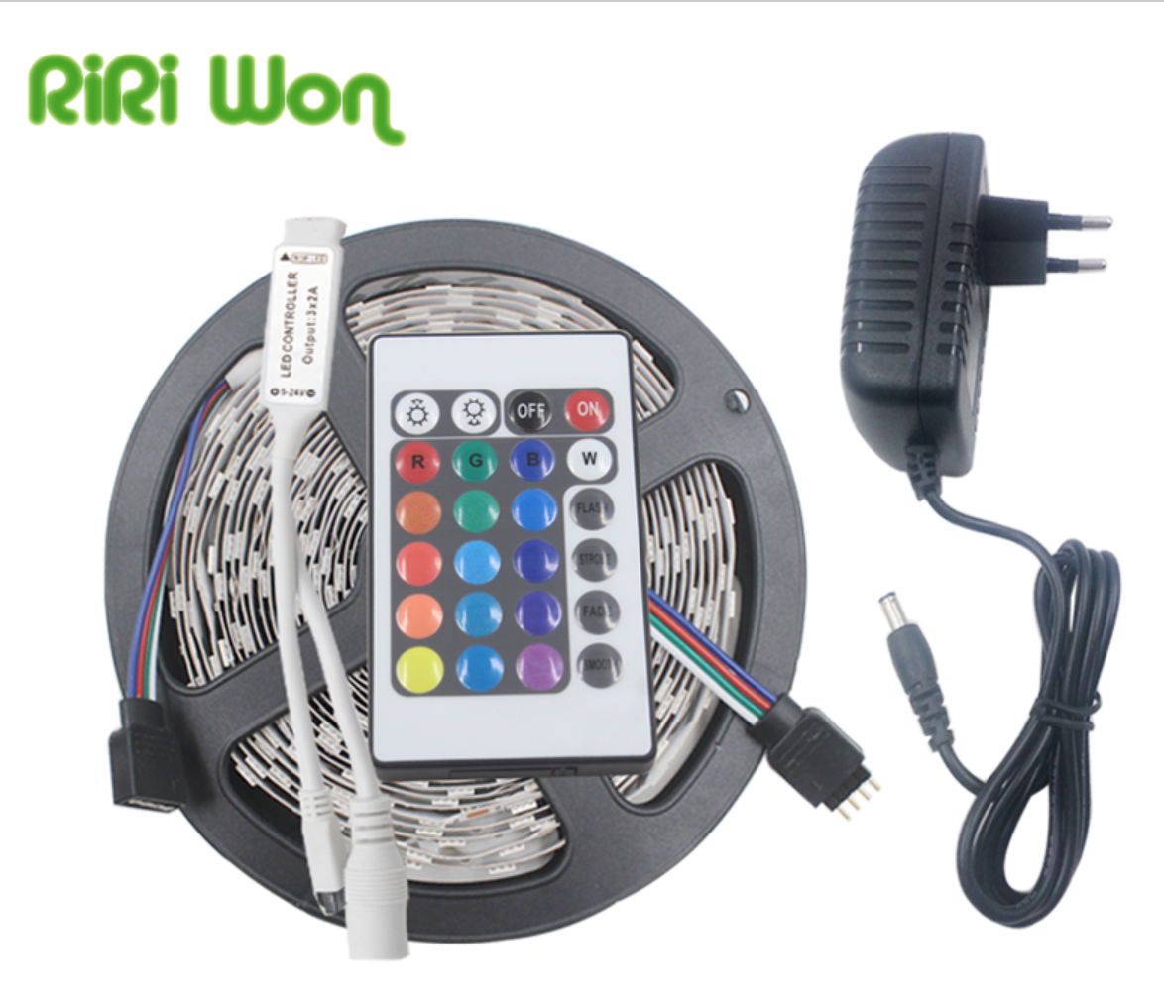
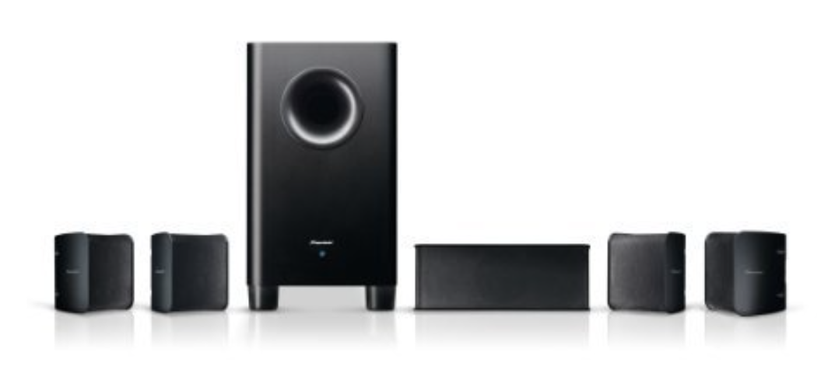
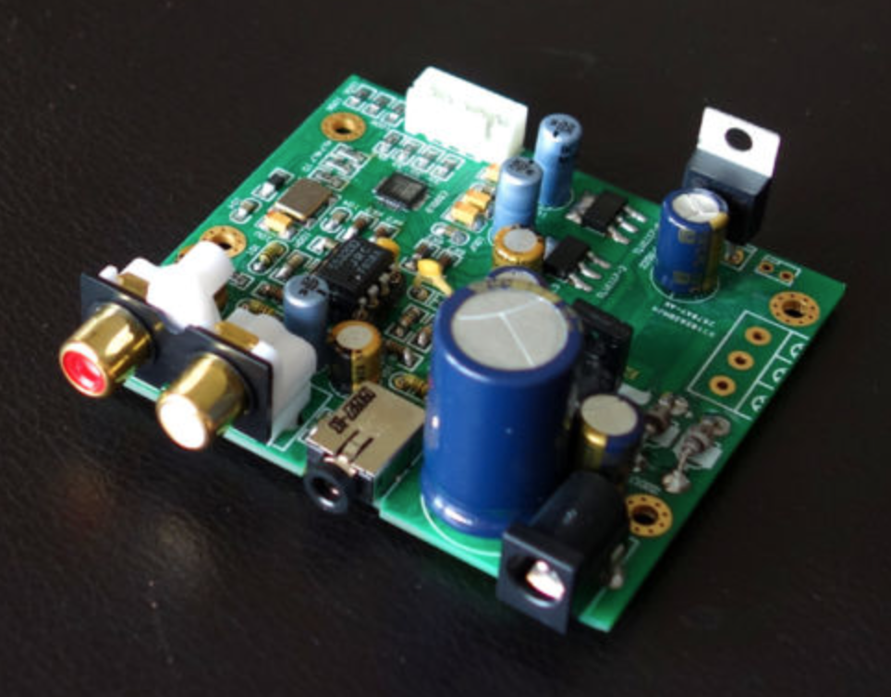
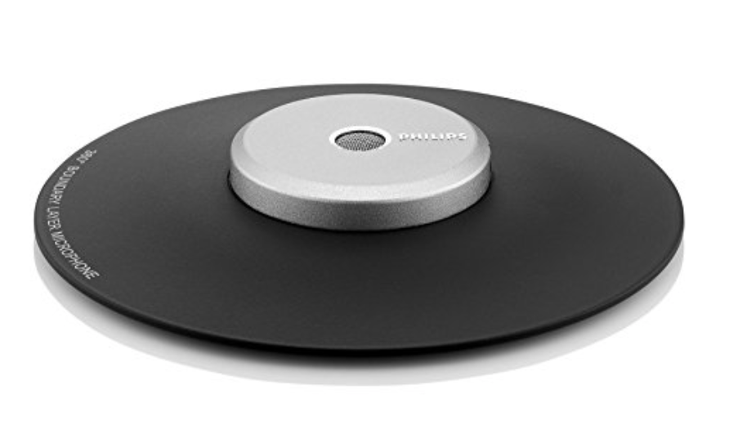
Convenience
General
Garage Door Opener
RGB Lighting
Garage Door Opener (Relay)
Room Microphone
Vacuum Robot (IR)
Sound System
I2S DAC

Slide 15
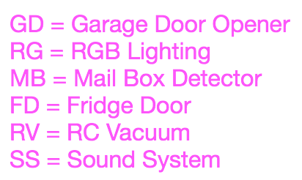
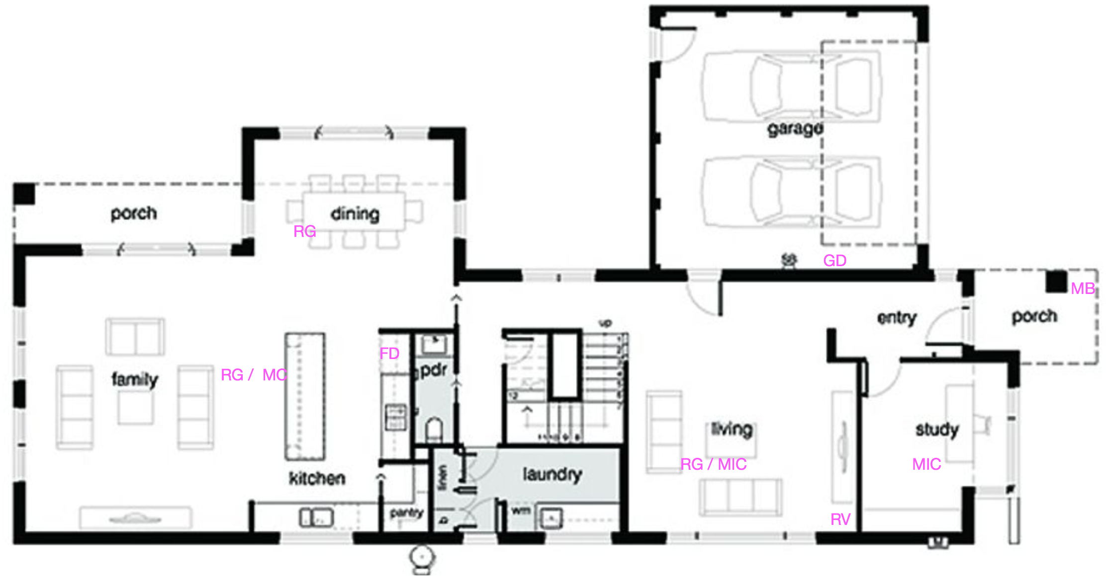
Convenience – Ground Floor
Total Sum: 5617€

Slide 16
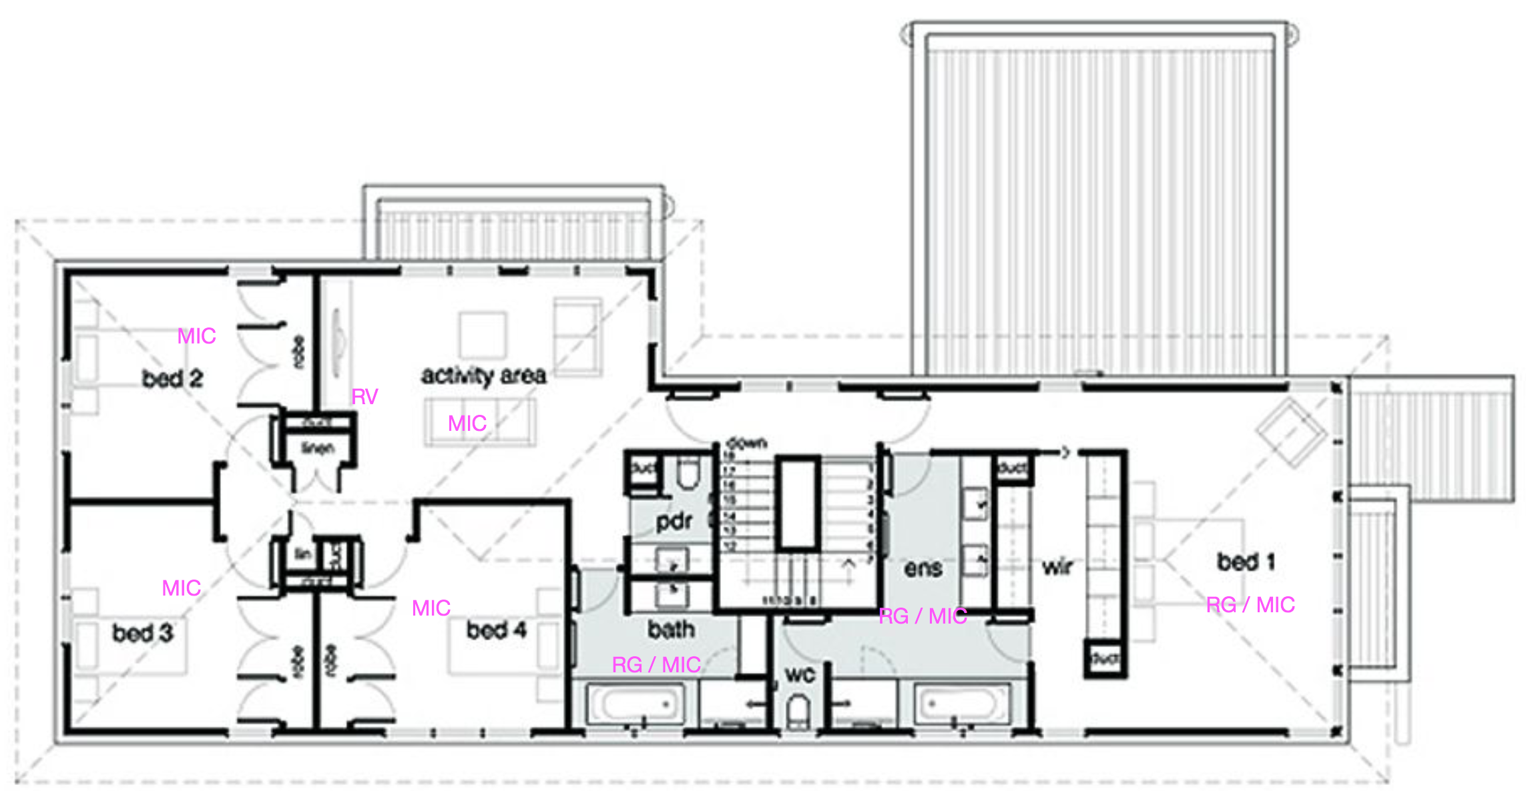
Convenience – Upper Floor
Total Sum: 7100€

Slide 17
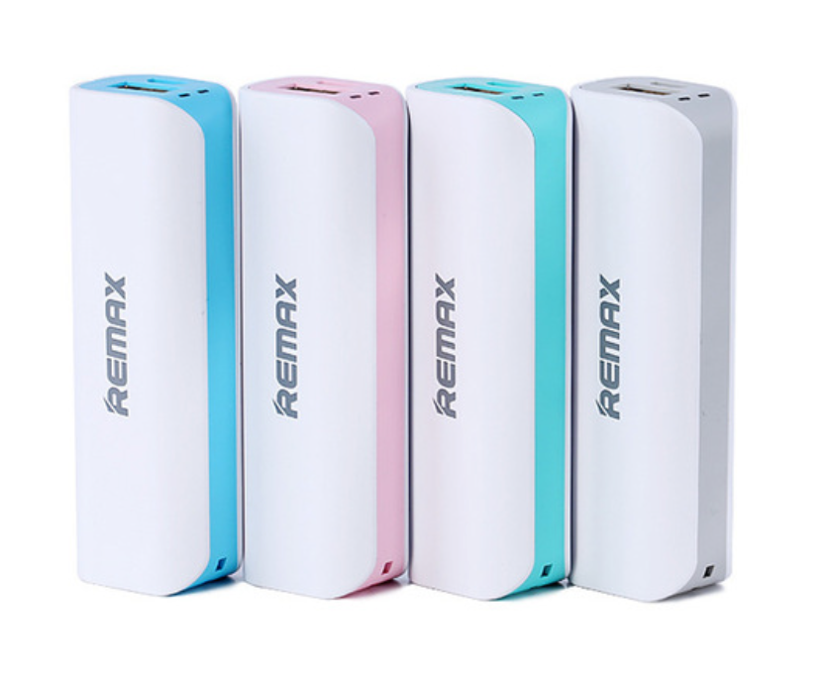
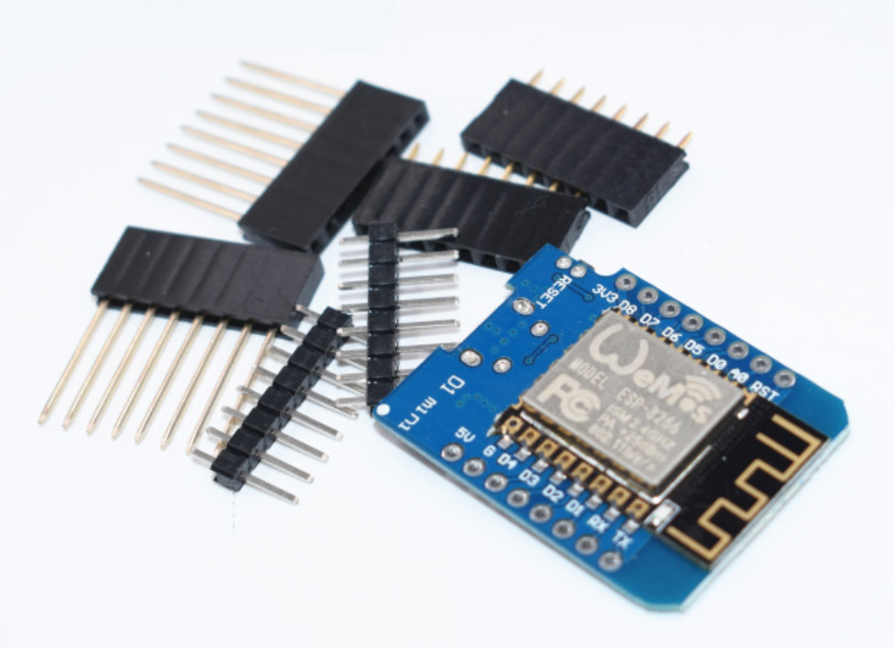
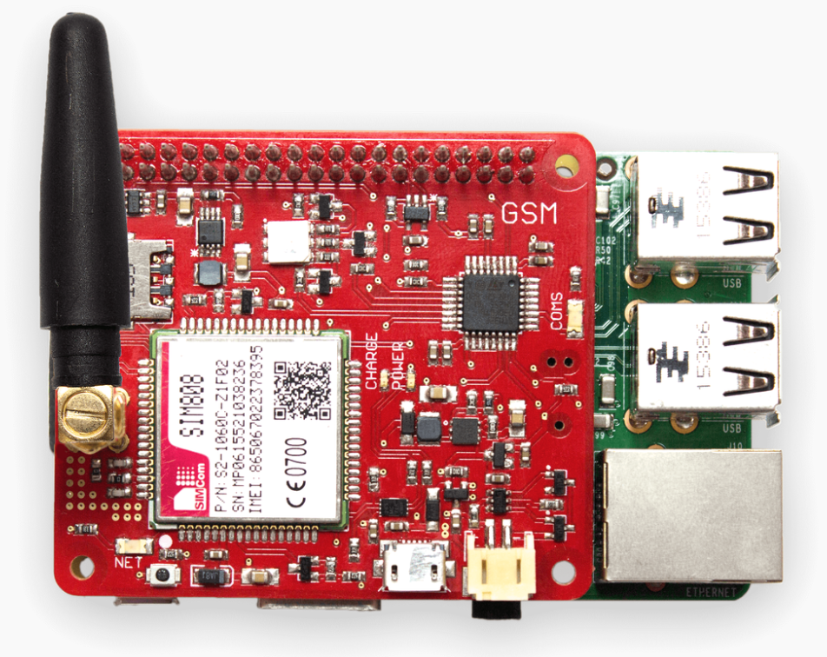
Control
General
33 ESPs
4 Raspberry Pis
PoE+ Shield
2G Cellular Shield
Power Banks
Lots of Micro USB Cables

Slide 18
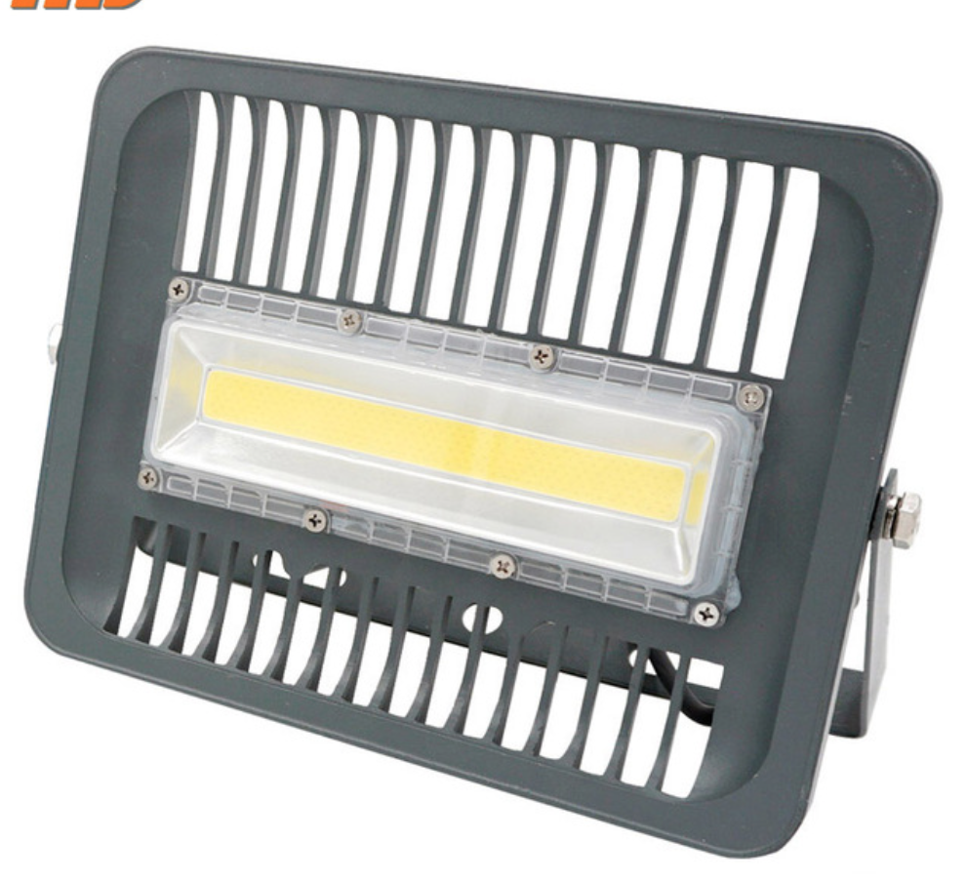
Garden
General
Pool Cover RC (Relay)
(Waterproof) RGB Lighting
Pool Pump RC (Relay)
Lighting + Motion Sensor
Total Sum: 7183€

Slide 19
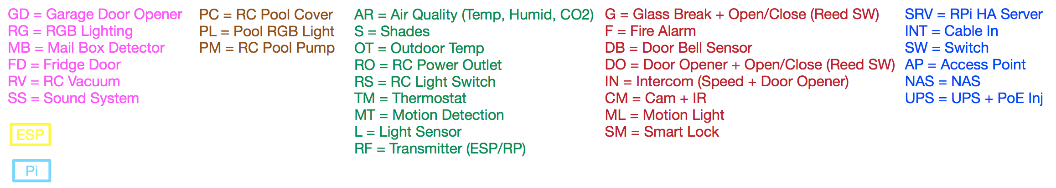
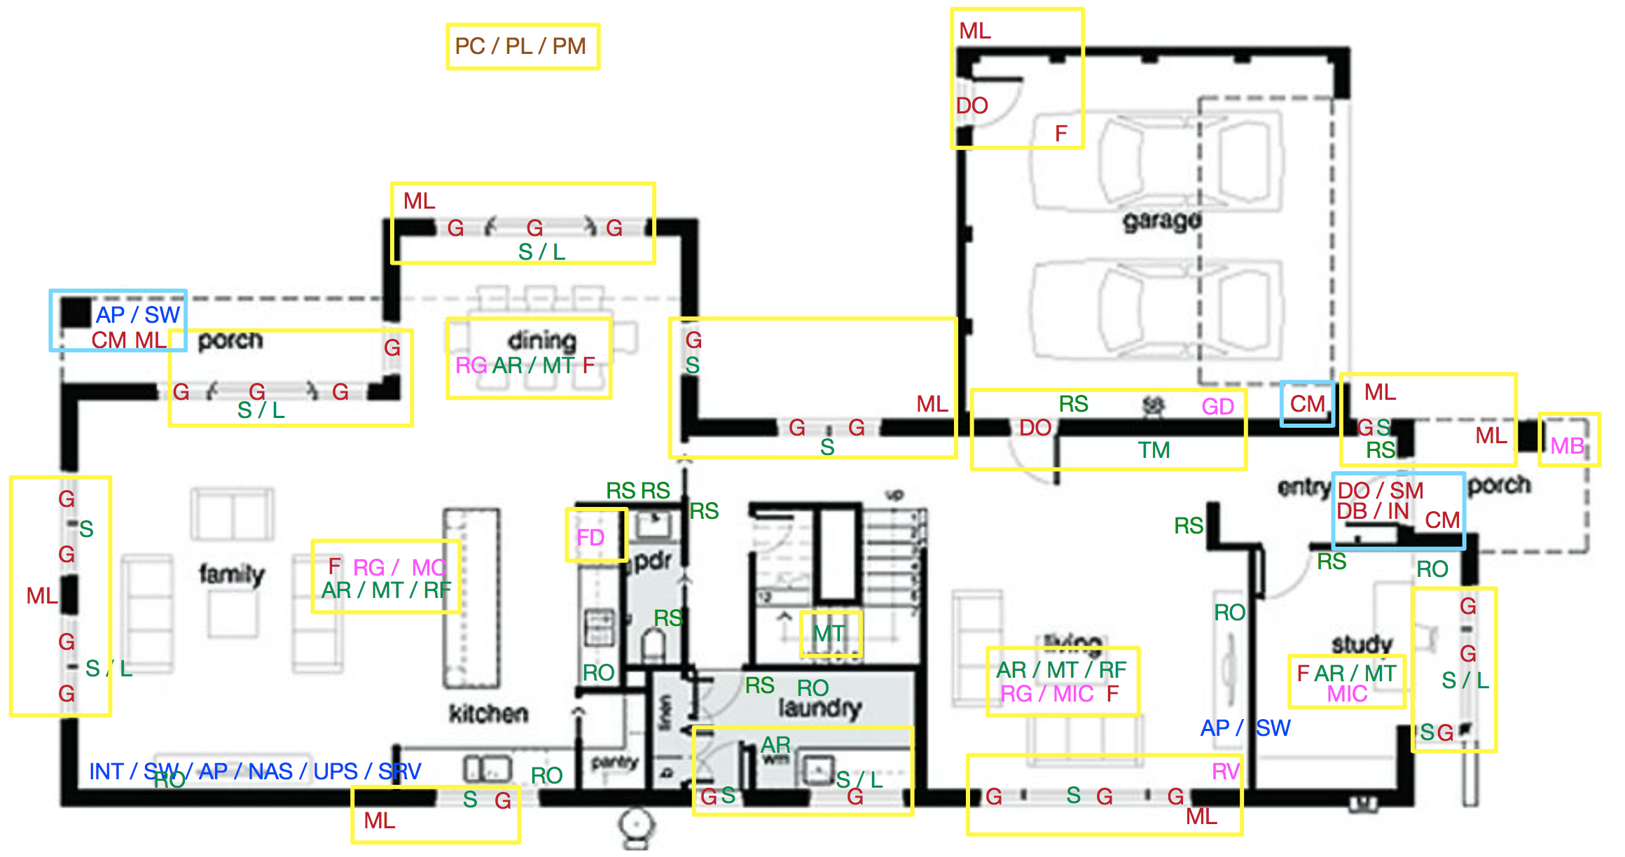
Convenience – Ground Floor
Total Sum: 7683€

Slide 20
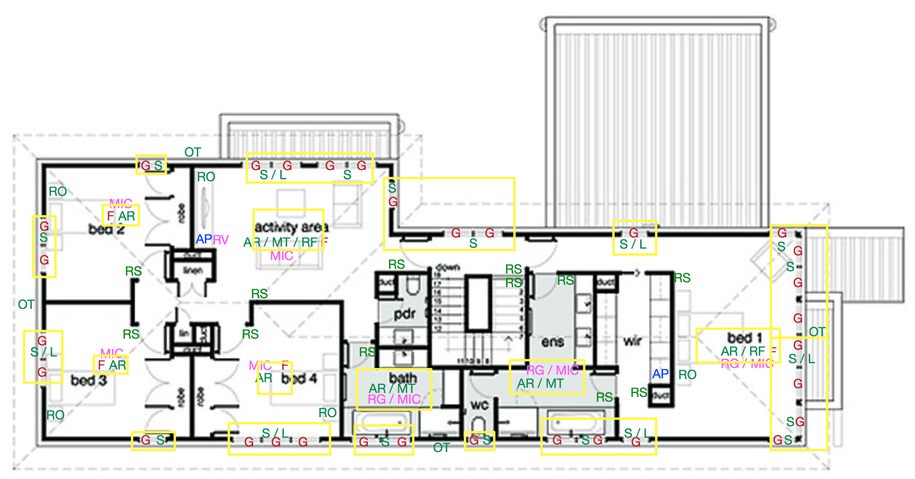
Convenience – Upper Floor
Total Sum: 8211€

Slide 21
Work Packages
General
10h Buy Stuff
80h Wiring (Power, Ethernet)
40h Pre-build ESP + Sensors
80h Installation
20h Software Setup
50h++ Automate Stuff
~280h Total
Total Sum: 7183€

Slide 22
Q&A

